Slide 1

Attribute Driven Design Case Study
Upgrade a Banking System to Digitally Sign Bank Statements
From: Designing Software Architectures, A Practical Approach; Humberto Cervantes, Rick Kazman; Addison-Wesley, 2016.

Slide 2
Business Problem
Regulations have changed and we’re now required to digitally sign bank statement.
The process will be as follows:
  On a monthly basis, the system executes a batch process, which retrieves raw bank statement information from a data source (an external database) and the performs a series of validations on this data to generate the bank statements and prepare them for digital signature by an external provider. These statements are sent to the provider, which returns the signed bank statement. These statements are then stored by the bank for further processing, including sending the statements to the customer. Each run will process approximately 2 million bank statements.
  The initial development effort completed only the core portion of the system. A second release is needed to provide a friendly interface with the system to monitor the state of the bank statement processing, to request reprocessing of incorrect statements and to generate reports.

Slide 3
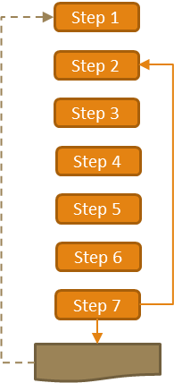
ADD Step 1
Review Inputs: Ensure the architecture drivers are available and correct
  Design Purpose – This is a brownfield system in a mature domain. The purpose is to design for the next system release
  Primary Functionality – Provide the ability query and process statements
  Quality Attributes –
    Reliability
    Performance Existing Quality Attributes
    Availability
    Security – New, this was not an issue with the batch system.
  Constraints –
    User accounts and permissions are handled by an existing user directory service that is used by various applications in the bank
    Communication with the data source is through JDBC
    Communication with the digital signing service is via Web Services. The Web Services receive and return information in XML adhering to a government specified schema.
    The system must be accessible via a web browser and only on the Bank intranet.
  Architectural Concerns –
    Introduction of new functionality, as much as possible, must avoid modification to the existing batch processing system
    The system shall be programmed in Java and use Java related technologies to leverage the expertise of the development team

Slide 4
Quality Attribute Scenarios
Reliability
  Under normal operating conditions, the batch process is executed in entirety 100% of the time.
Performance
  Under normal operating conditions, when the batch process starts, 2 million bank statements are read, processed, and sent to the signing provider in at most one hour.
Availability
  During normal processing, a failure may occur when reading information form the data source or when sending information for digital signature. A notification is then sent to the administrator, who manually restarts the process. When it is restarted, only the information that had not already been processed is treated.
Security
  A user performs any operation on the system at any moment, and 100% of the operations performed by the user are recorded by the system in the operations log.

Slide 5
ADD Step 2
Establish Iteration Goal by Selecting Drivers
    The goal of this iteration is to modify the existing design to support all of the new drivers (quality scenarios).
    Only a limited number of drivers need to be addressed (Security, Reliability, Performance, Availability), so only a single iteration is sufficient.

Slide 6
ADD Step 3
Choose One or More Elements of the System to Refine
The elements to refine include the main modules for the Bank System and node where the system is deployed. In addition to refining these modules, the physical node where the application is based is a candidate for refinement.

Slide 7
ADD Step 4
Choose One or More Design Concepts that Satisfy the Selected Drivers
Leverage existing solutions, combine and adapt them as necessary
Use the Web Application Reference architecture – A constraint was to access the system through a web browser
  Discarded Rich Internet application reference architecture due to constraints

Slide 8
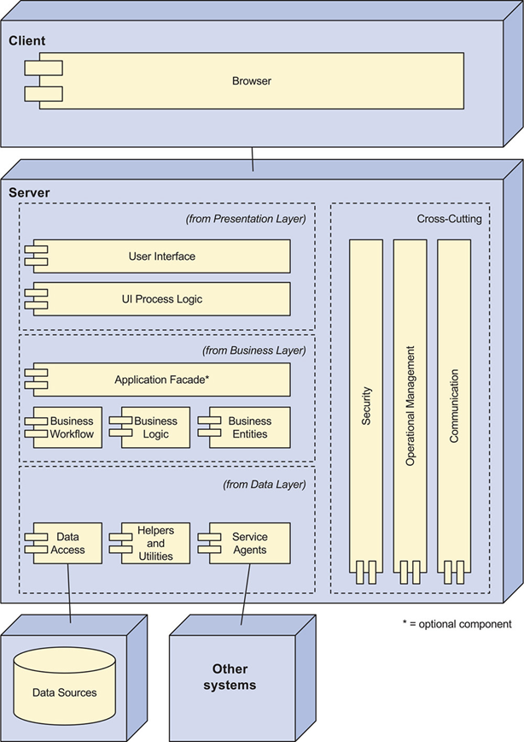
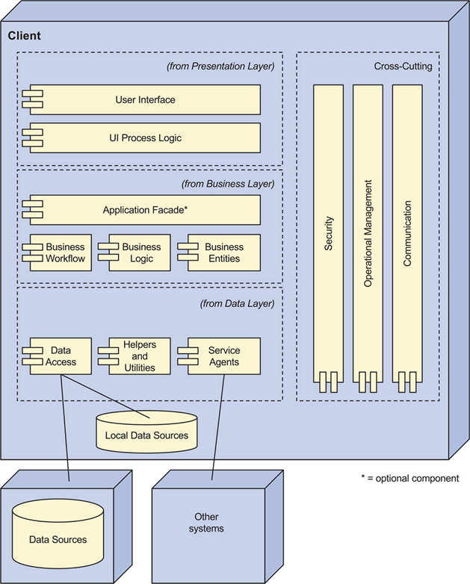
ADD Step 4
Web service reference Architecture
Rich client Reference architecture

Slide 9
ADD Step 4
Choose One or More Design Concepts that Satisfy the Selected Drivers
Leverage existing solutions, combine and adapt them as necessary
Select Spring Security framework to manage authorization and authentication – Need to manage authentication and authorization along with a activity log
  The existing software was built using the Spring framework. Continuing to leverage Spring fits into the existing paradigm
  Writing ad hoc code is challenging, error-prone, and takes significant time to develop

Slide 10
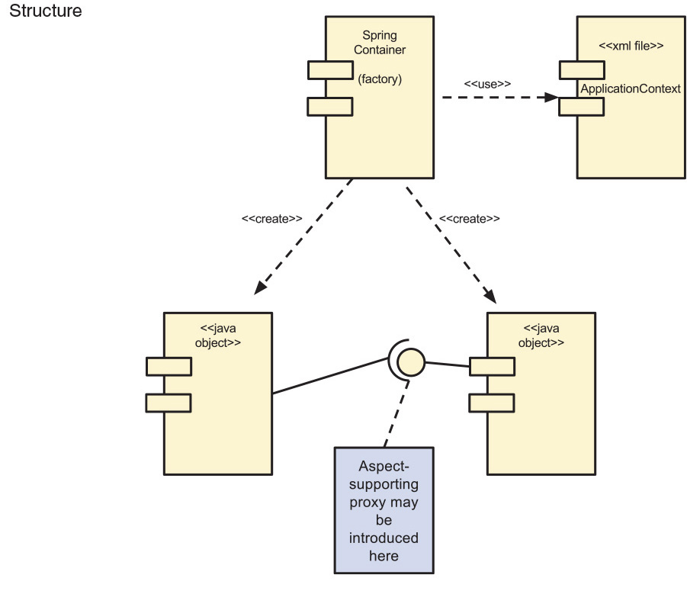
ADD Step 4: Spring
The framework supports several aspects using AOP which are introduced as proxies between the Java objects when container connects them. Supported aspects include:
  Security
  Transaction Management
  Publishing object interfaces so the objects can be accessed remotely

Slide 11
ADD Step 4
Choose One or More Design Concepts that Satisfy the Selected Drivers
Leverage existing solutions, combine and adapt them as necessary
Use the Shared Database Integration pattern to obtain information about the state of bank statements – The interactive part of the system needs to query the same database used by the batch process.
  Discarded obtaining the information through an API, which would require modifications in the existing modules and would have a negative impact on performance

Slide 12
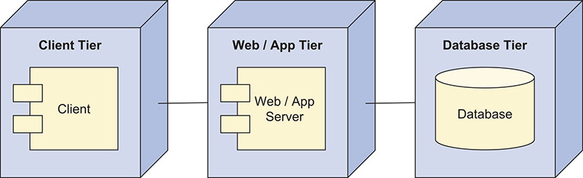
ADD Step 4
Choose One or More Design Concepts that Satisfy the Selected Drivers
Leverage existing solutions, combine and adapt them as necessary
Deploy using a three-tier deployment model – Deploying the web part of the application will be done in a separate server
  Discard hosting the application in the same server where the batch process is hosted. This would save some server costs, but could limit performance of either the batch process or the interactive functions.

Slide 13
ADD Step 5
Instantiate Architectural Elements, Allocate Responsibilities and Define Interfaces
Apply the design concept to the element(s) under consideration
Design Decision and Location | Rationale
Host the web application in a separate server | This choice avoids performance reductions on the batch server and increases security
Configure Spring Security to use an external user directory server | Constraint to used existing external directory service

Slide 14
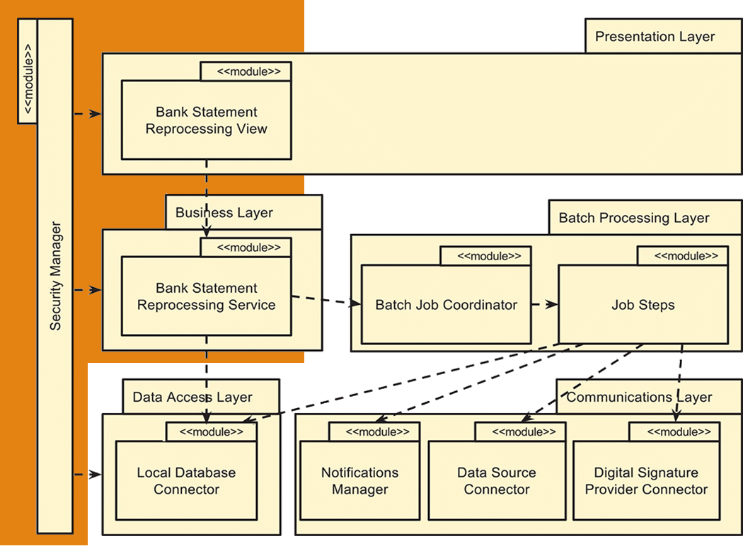
ADD Step 6
Sketch Views and Record Design Decisions
Modules introduced to support querying and reprocessing statements

Slide 15
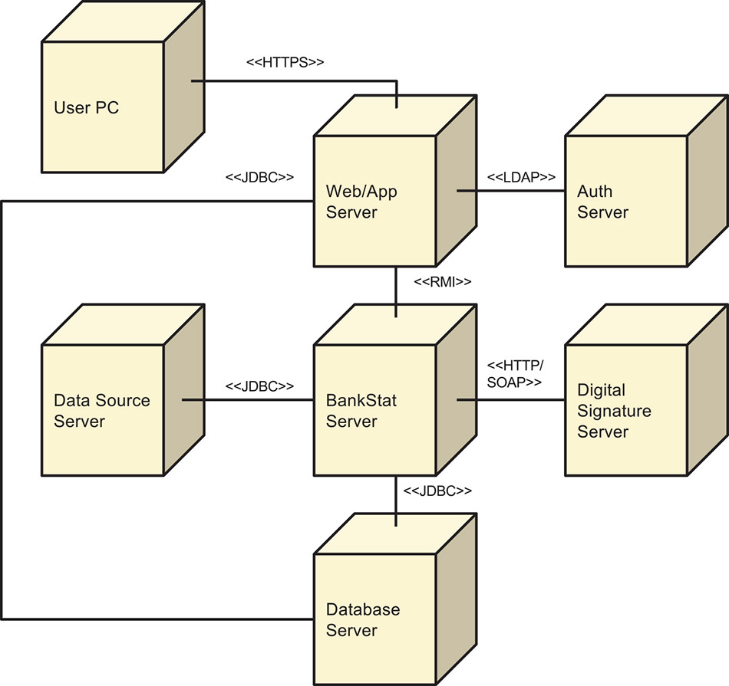
ADD Step 6
Sketch Views and Record Design Decisions
Deployment Diagram

Slide 16
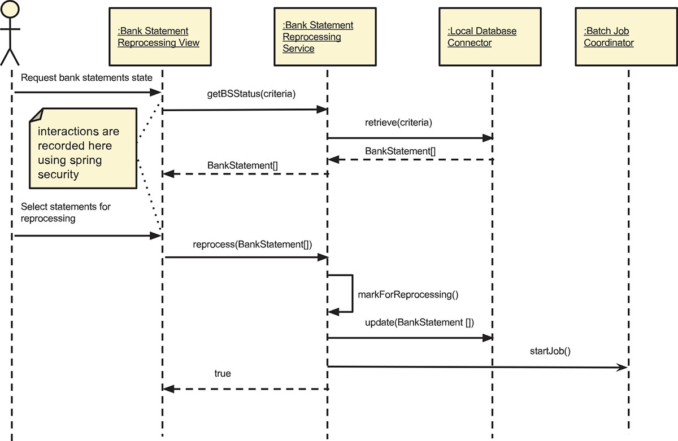
ADD Step 6
Sketch Views and Record Design Decisions
Sequence Diagram for new functionality

Slide 17
ADD Step 7
Perform Analysis of Current Design and Review Iteration Goal and Achievement of Design Goal
  Modules that support the use case and their interactions were identified and defined based on the Web Application Reference architecture
  Security Logs are handled by Spring Security
  Spring Security connects to the existing user directory server and uses its information to support authorization and authentication
  No changes have been made to the module that connects to the data source
  No changes have been made to the module the connects to the digital signature provider
  The Web Application Reference architecture that was used specifically supports access from web browsers
  The technologies that have been select are Java related
  Integration with the existing functionality was made through the database (using the Database Integration pattern). Changes to the existing functionality were not needed

